Slide 1
DEVELOPMENT OF THE LIMBS
Ngwazi DR. K.O. AWORI
University of Nairobi

Slide 2
OBJECTIVES
I. ONTOGENY
Sources of mesenchyme for limb development
Limb development as a self-differentiating system.
Stages of limb development
Factors affecting limb development

Slide 3
OBJECTIVES
II. TERATOLOGY
Mechanisms of limb malformations
Common causes and examples of limb malformations

Slide 4
Introduction
Limbs are designed to serve mechanical functions.
The upper limb functions include prehension and tactile sensibility.
The lower limbs are for weight bearing and locomotion.

Slide 5
Introduction
Limb development is a complex process that is coordinated by various tissue components through close interaction.
It begins only after musculature of the body wall beneath the undifferentiated limb bud is already well differentiated.

Slide 6
Introduction
At any given time, upper limbs are more
developed than the lower ones till the end of
limb development when the two are nearly
synchronised.

Slide 7
Sources of mesenchyme for development
Lateral plate mesoderm:
bones, tendons, ligament
connective tissue & vasculature.
Somitic mesoderm:
gives rise to the musculature

Slide 8
Sources of mesenchyme for development
Neural crest:
form melanocytes and Schwann cells.

Slide 9
Initiation of limb development
Limb development begins with initiation of a group
of mesenchymal cells in the lateral plate
mesoderm.

Slide 10
Initiation of limb development
The signal for limb bud formation comes from LPM cells that will become the prospective limb mesenchyme.
Around T1
They produce FGF10
Role of retinoic acid expression

Slide 11
Initiation of limb development
The initiated mesoderm then influences the
overlying surface ectoderm to thicken to
form a limb disk.
Mesoderm to be considered
as the prime mover of limb development.

Slide 12
Initiation of limb development
The primordium formed by the meso-ectodermal interaction, contains all the information required to attain the normal limb form even if removed from the body of the embryo;
the so called self-differentiating system.

Slide 13
Initiation of limb development
The homeobox genes are involved in
limb development.

Slide 14
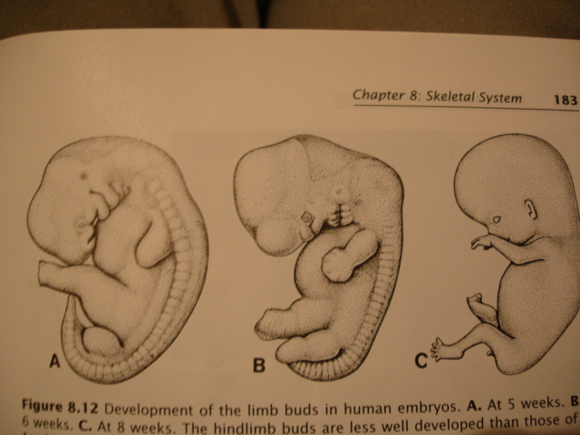
Organisation of the limb bud
The limb buds appear on the ventrolateral body wall by week 4
The upper limb buds are visible by day 24 or 25 while the lower limb ones by day 27 or 28.

Slide 15
Organisation of the limb bud
The apical ectodermal ridge (AER) stimulates outgrowth by its influence on the progress zone.

Slide 16
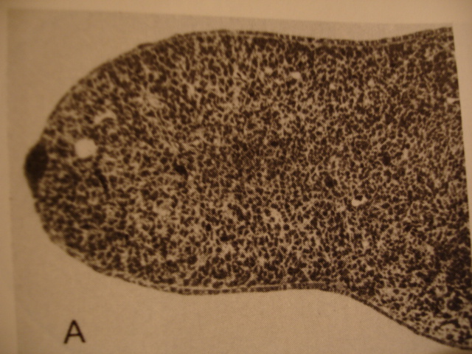
Organisation of the limb bud parts;
MESODERM
AER
PROGRESS
ZONE
ECTODERM

Slide 17
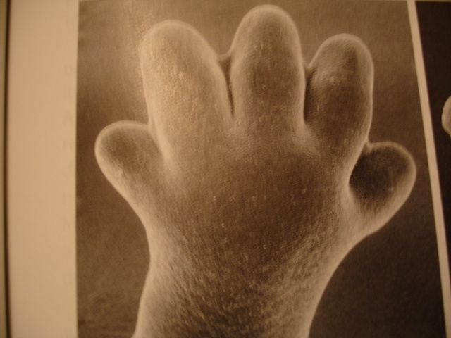
Organisation of the limb bud
Fingers and toes form by programmed death (apoptosis) of cells between the digital rays.

Slide 18
Differentiation of specific tissues:
BONE
Most limb bones ossify between week 5 and 12 except carpal bones and some tarsal bones that do after birth.
The bones, except the clavicle ossify endochondrally
Joints develop from mesenchymal interfaces.

Slide 19
Differentiation of specific tissues
MUSCLES
During the 5th week the mesenchyme from the
somitic mesoderm upon migration, condenses into
a ventral and dorsal masses with respect to the
axial mesenchyme.
.

Slide 20
Differentiation of specific tissues
MUSCLES
These cells form individual muscle primordia
that link with tendons and connective tissue
components, and differentiate into
myoblasts that give rise to various muscles
of the limbs.

Slide 21
Differentiation of specific tissues
MUSCLES
While some muscles migrate generally,
  The dorsal mass gives rise to upper limb
  extensors and supinator and lower limb
  abductors,
  The ventral mass to flexors and pronators of
  the upper limb and flexors and adductors of
  the lower limb.

Slide 22
Differentiation of specific tissues
NERVES
The innervation develops much later
The limb muscles are innervated by the ventral primary rami of spinal nerves C5 to T1 and L4 to S3 for upper and lower limbs respectively.
The dorsal divisions of the nerves supply the dorsal muscle mass while ventral divisions the ventral mass.

Slide 23
What determines the pattern of nerves in a limb (Axonal path-finding)?
1. Configuration of other tissue components in the limb:
- in-growing nerves follow environmental cues. The
growth cones of axons avoid or may be unable to
penetrate regions with dense mesenchyme or
with glycosaminoglycans.
2. Pre-determined structures:
- That the axons home-in upon the structures they
are pre-determined to innervate.

Slide 24
Limb rotation
The limb buds rotate from their original coronal orientation into a more or less parasagittal orientation.
They rotate through 90⁰ around their long axis, the upper limbs laterally and the lower ones medially.

Slide 25
II. TERATOLOGY
Aetiology
In majority, the cause is unknown
In most cases the cause is multi-factorial, resulting from interaction between genetic and environmental factors.
Some of the environmental factors include chemicals/drugs such as thalidomide (amelia/phocomelia), and retinoic acid,
Oligohydriamnios is associated with the amniotic band disruption complex

Slide 26
CLASSIFICATION & EXAMPLES
Failure of formation (amelia, phocomelia, congenital amputations, absence of radius or ulnar, tibia or fibula)
Failure of differentiation (syndactyly)
Duplication (polydactyly)
Overgrowth (macrodactyly or gigantism)
Undergrowth
Constriction bands
Generalized skeletal abnormalities (club foot)

Slide 27
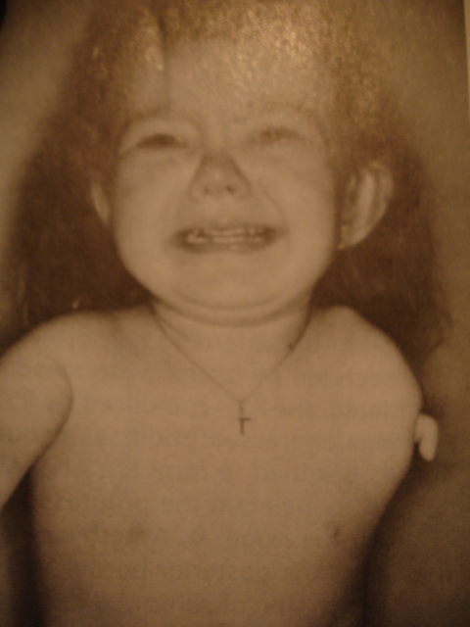
AMELIA

Slide 28
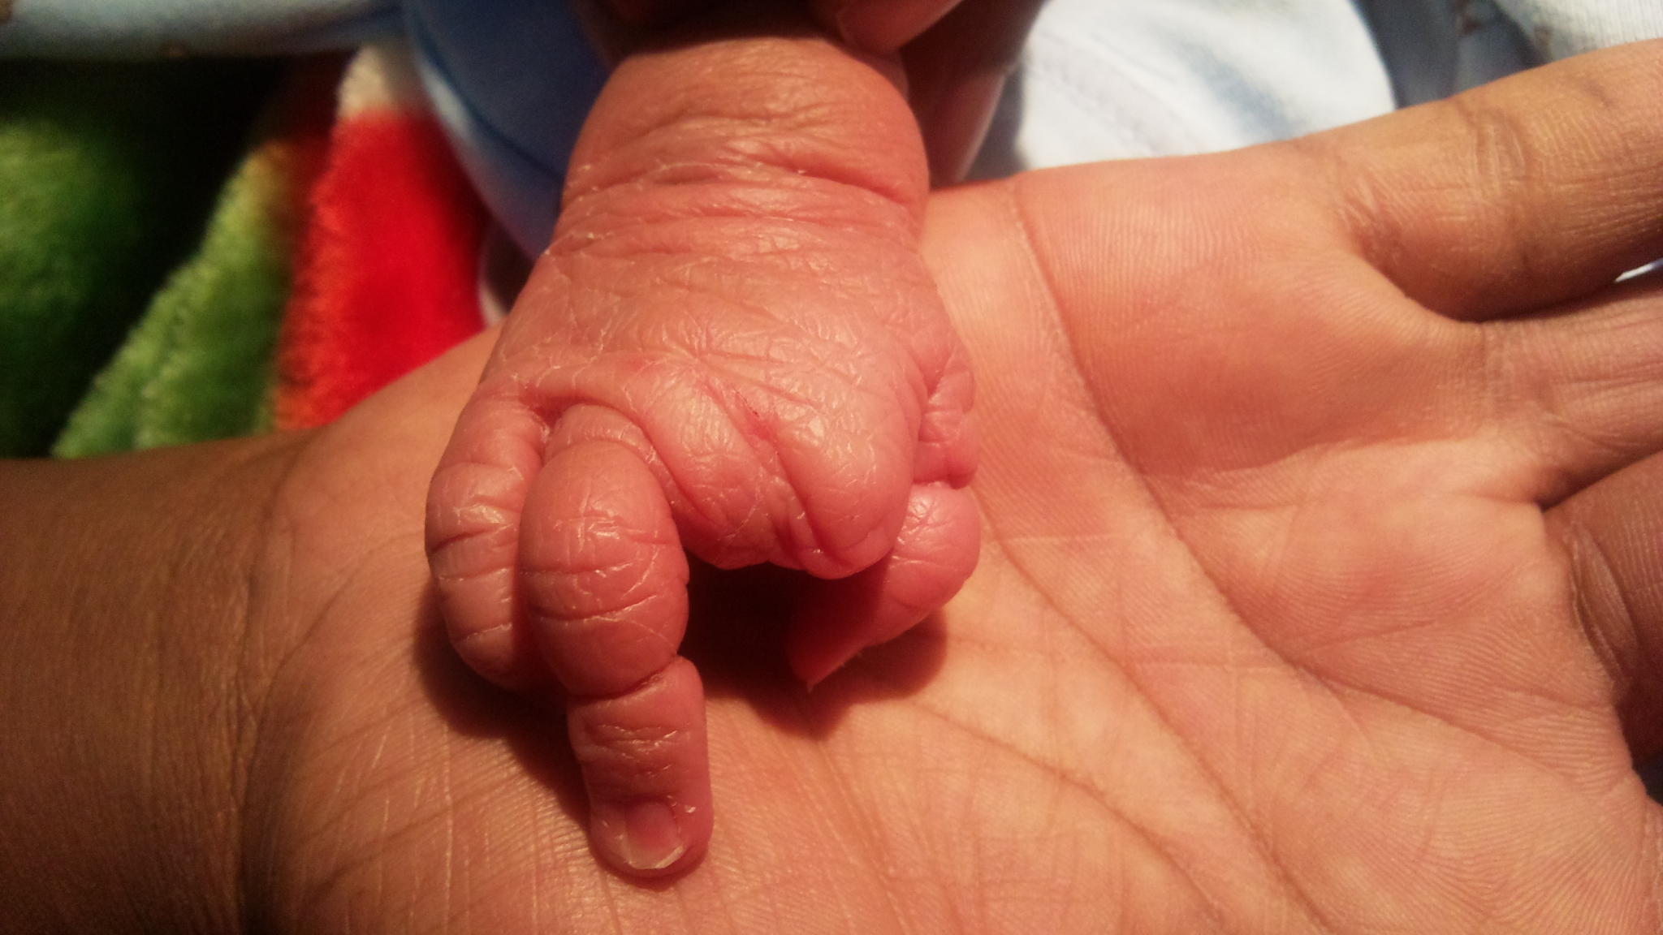

Slide 29
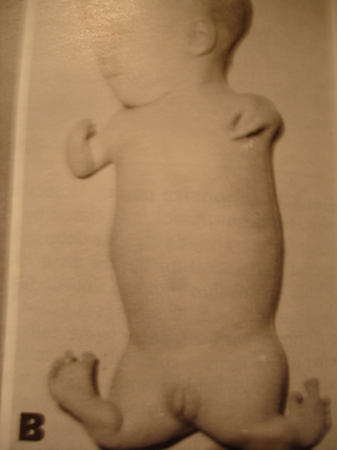
PHOCOMELIA

Slide 30
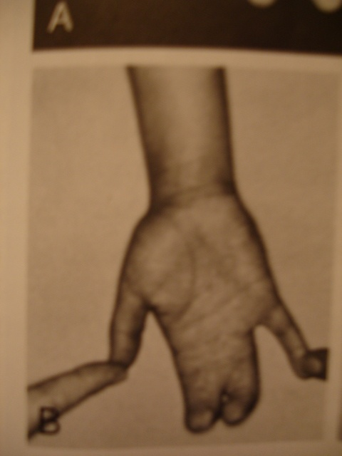
SYNDACTYLY

Slide 31
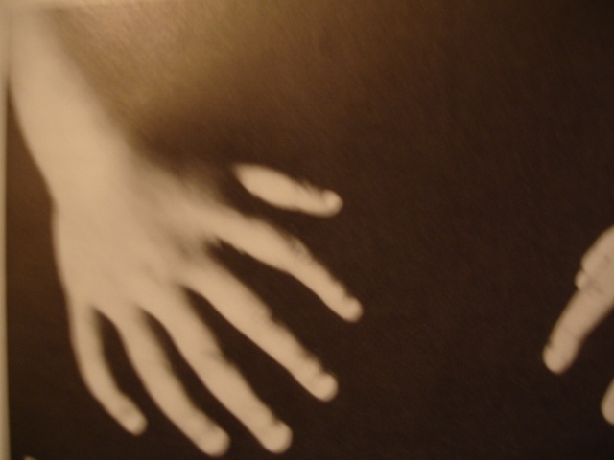
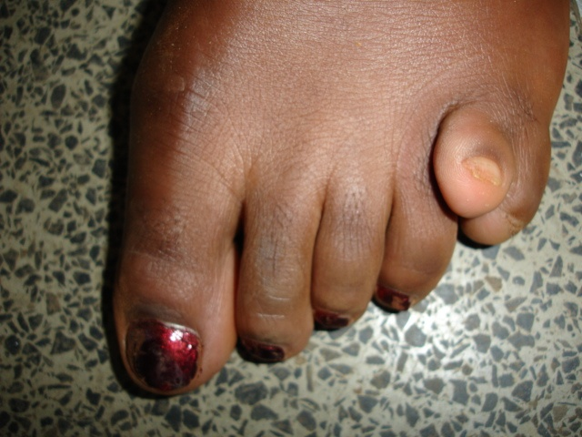
POLYDACTYLY

Slide 32
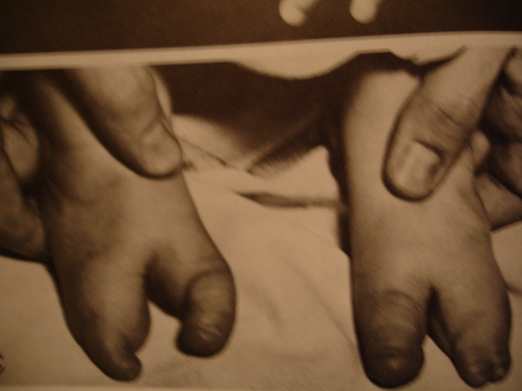
CLAW FEET
(LOBSTER DEFORMITY)

Slide 33
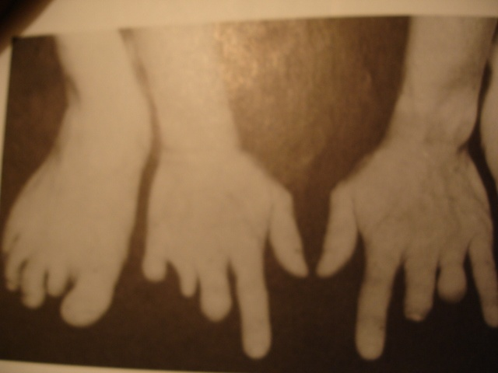
CONGENITAL DIGIT AMPUTATIONS

Slide 34
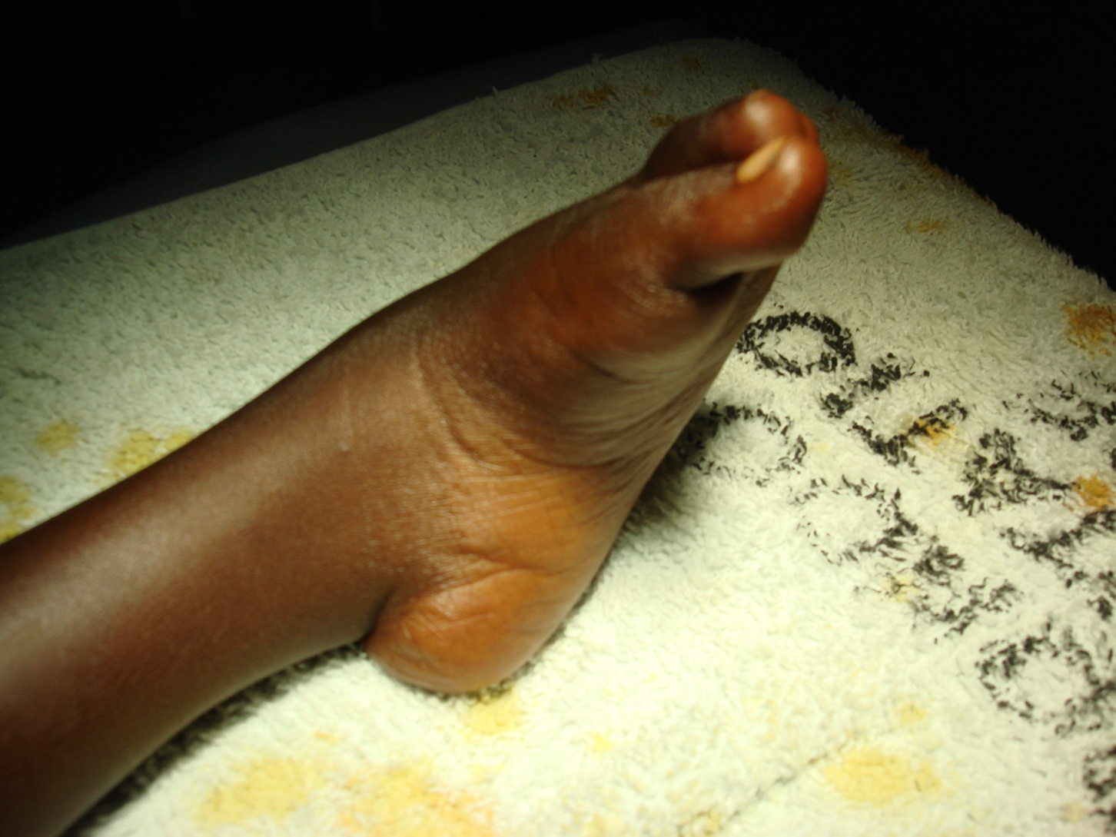
CLUB FOOT

Slide 35
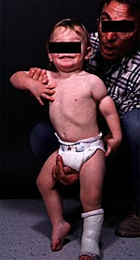
CONSTRICTION BAND

Slide 36
SUMMARY
Origin of mesenchymal cells
Lateral plate mesoderm:
bones, tendons, ligament
connective tissue & vasculature.
Somitic mesoderm:
gives rise to the musculature
Neural crest:
form melanocytes and Schwann cells.

Slide 37
SUMMARY
Initiation:
- LPM through FGF10
- Retinoic acid
- Role of homeobox genes (induction factors)
Limb bud parts: AER & Progress zone
Growth: elongation, innervation & rotation

Slide 38
SUMMARY
Teratology
Role of specific teratogens: Thalidomide &
retinoic acid
Mechanisms of causation: e.g Amniotic
band disruption complex

Slide 39
THANK YOU AND GOD BLESS YOU

